Slide 1
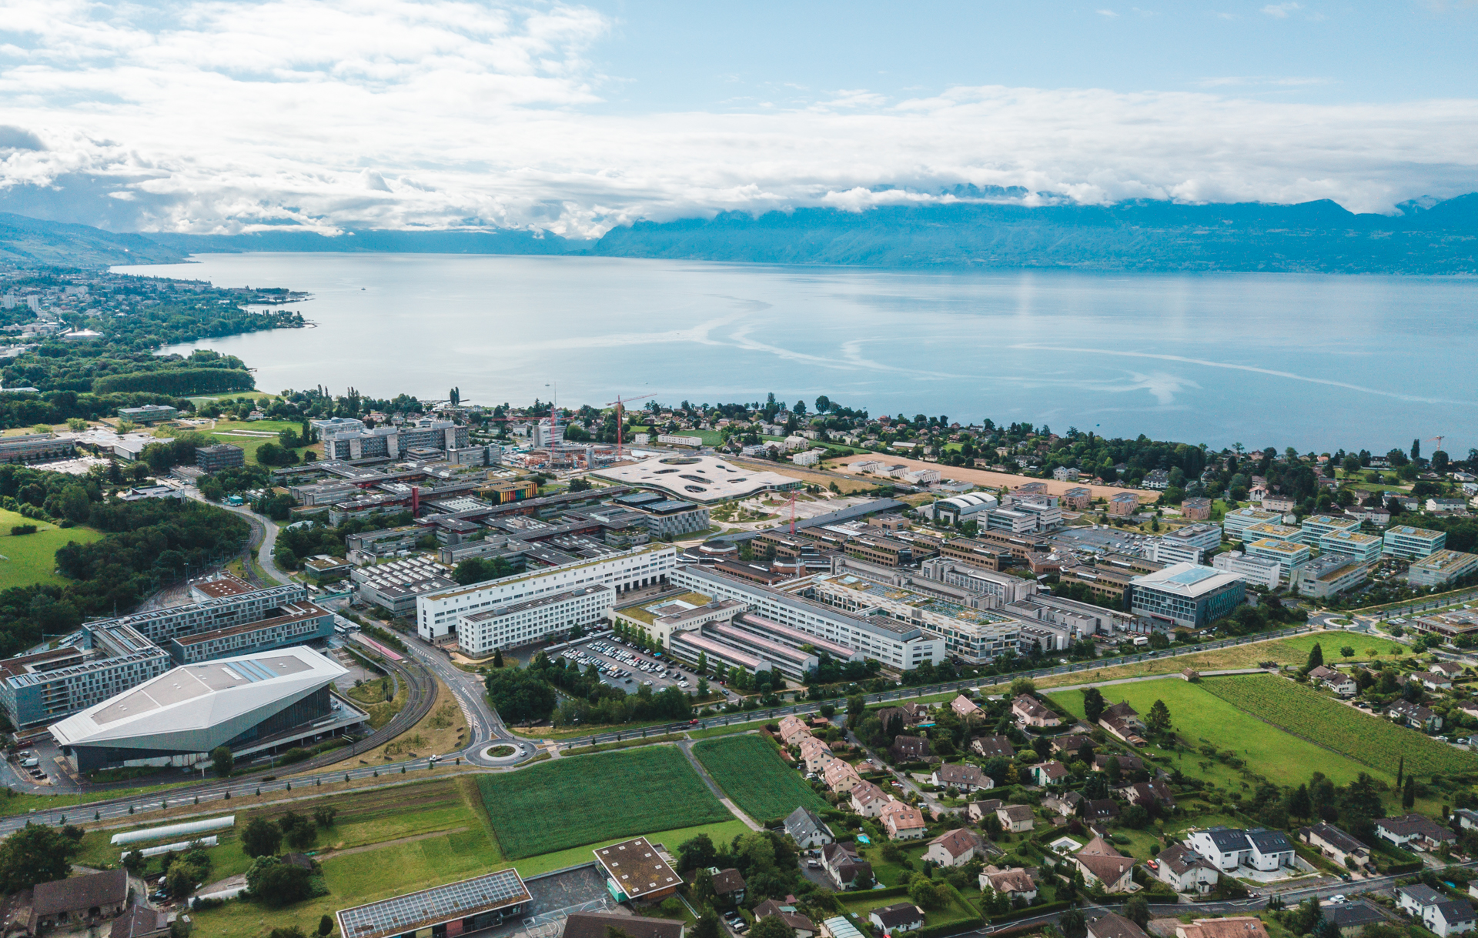
MSE-433 Debates
Debate n°
Your debate title (same as in the following slides)
Your name
Debate date

Slide 2
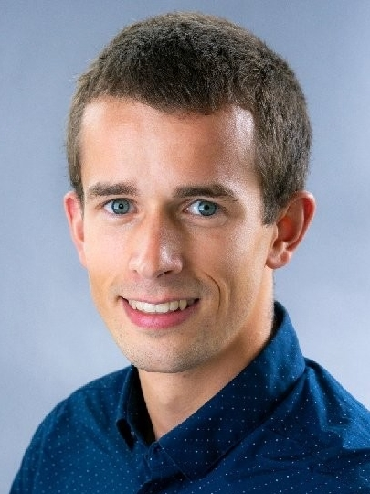
Slide Title Student name:
Your picture
You can use as many slides as you want … taking into account the 3 minutes time limit for your presentation. We recommend 3 slides.
You are free to use pictures, videos, graphs, text … and make sure you cite all your sources!
As a reminder, your debate presentation represents 10% (10 pts) of the final grade:
quality of presentation (4 pts)
presentation dynamics (3 pts)
quality / coherence of references (3 pts)

Slide 3
3rd March Debate 1 (YL, Brynja with OMNIS) What are the stakeholder impacts of materials from the perspective of the global north & global south?
First name | Last name | Email address | Order of presentations
Wieland Maximilian | Apel | wieland.apel@epfl.ch | 1
Quentin Raphaël Vincent | Gaillard | quentin.gaillard@epfl.ch | 2
Yoan | Cangemi | yoan.cangemi@epfl.ch | 3
Maurus Sebastian | Lozza | Maurus.lozza@epfl.ch | 4
Claire Liliane Marie | Pinson | claire.pinson@epfl.ch | 5

Slide 4
17th March Debate 2 (YL, JB) What are the impacts of petrochemical extraction vs NetZero economies?
First name | Last name | Email address | Order of presentations
Natacha Helena Victoria | Kruzic | natacha.kruzic@epfl.ch | 1
Clara | Guadalupe Herrera | clara.guadalupeherrera@epfl.ch | 2
Anouk | Paulino | anouk.paulino@epfl.ch | 3
Matheo Marcel Giacomo | Godenzi | matheo.godenzi@epfl.ch | 4
Gaïane Marie Alice Marc | Fromage | gaiane.fromage@epfl.ch | 5

Slide 5
24th March Debate 3 (MDW, Brynja) To what extent are bio-materials scalable with respect to planetary boundaries, water and land system change vs. agriculture & diet?
First name | Last name | Email address | Order of presentations
Germana | Sergi | germana.sergi@epfl.ch | 1
Samuel René François | Desmurs | samuel.desmurs@epfl.ch | 2
Mark | Proupes | mark.proupes@epfl.ch | 3
Albin Georges Jean | Mermoud | albin.mermoud@epfl.ch | 4
Anthony Jean Michel | Varaillon-Divanis | anthony.varaillon-divanis@epfl.ch | 5
Alexandre | Bai | alexandre.bai@epfl.ch | 6

Slide 6
31st March Debate 4 (MDW, Lei) What are the merits and limitations of industrial decarbonization vs carbon off-setting, CCUS, and carbon credits?
First name | Last name | Email address | Order of presentations
Pin-Ying | Chen | pin-ying.chen@epfl.ch | 1
Sebastian Willem | Leser | sebastian.leser@epfl.ch | 2
Leila Claudia | Mégevand | leila.megevand@epfl.ch | 3
David | Kerzel | david.kerzel@epfl.ch | 4
Arthur Gilles Thomas | Simon | arthur.simon@epfl.ch | 5
Alice | Giorgetti | alice.giorgetti@epfl.ch | 6

Slide 7
14th April Debate 5 (YL, JB) How to reduce the scope 1,2,3 impacts of a car?
First name | Last name | Email address | Order of presentations
Samuel Jacques-Henri | Jaunin | samuel.jaunin@epfl.ch | 1
Amandine Charlotte Raphaëlle | Nicolle | amandine.nicolle@epfl.ch | 2
Eric | Greulich | eric.greulich@epfl.ch | 3
Théo Anthony | Altherr | theo.altherr@epfl.ch | 4
Daniele | Belfiore | daniele.belfiore | 5
Felix Andrew | Wise | felix.wise@epfl.ch | 6

Slide 8
28th April Debate 6 (YL, Lei) How can we reduce the impingement of materials on the novel entities planetary boundary and human health?
First name | Last name | Email address | Order of presentations
Pierre-Arnaud Louis Christian | Vals | pierre-arnaud.vals@epfl.ch | 1
Tassilo | Friberg | tassilo.friberg@epfl.ch | 2
Selin | Kandiyoti Eskenazi | selin.kandiyotieskenazi@epfl.ch | 3
Antoine Georges Henri | Fotius | antoine.fotius@epfl.ch | 4
Lucie Julia | Caulier | lucie.caulier@epfl.ch | 5
Clara Mei | Vinet | clara.vinet@epfl.ch | 6
Allegra | Magnetti | allegra.magnetti@epfl.ch | 7

Slide 9
5th May Debate 7 (MDW, Claire) Discuss the different socio-economic pathways, the NetZero transition, and the role of societal change
First name | Last name | Email address | Order of presentations
Martin Jean Joseph | Sinègre | martin.sinegre@epfl.ch | 1
Sven Aramis | Jaquiéry | sven.jaquiery@epfl.ch | 2
Jian Yi Michael | Low | jian.low@epfl.ch | 3
Sydney | Bersier | sydney.bersier@epfl.ch | 4
Gaspar | Zimbrek-Turkovic | gaspar.zimbrek-turkovic@epfl.ch | 5
Thomas | Artru | thomas.artru@epfl.ch | 6

Slide 10
12th May Debate 8 (MDW with IMD, Claire) How to quantify humanity's progression: discuss GDP as a measure of prosperity / economic growth?
First name | Last name | Email address | Order of presentations
Anita Valentina | Manzolini | anita.manzolini@epfl.ch | 1
Alexandre Antoine | Hivorel | alexandre.hivorel@epfl.ch | 2
Yuki | Sadakane | yuki.sadakane@epfl.ch | 3
Danilo | Aliotta | danilo.aliotta@epfl.ch | 4
Osama | Ounallah Khamis | osama.ounallahkhamis@epfl.ch | 5
Candice Mathilde | Guilbaud | candice.guilbaud@epfl.ch | 6
Soheil | Nasiri | Soheil.nasiri@epfl.ch | 7

